Slide 1
Airbnb Price Prediction Using Regression Models
Lilly Sharples
lillysharples@uga.edu
21 September, 2021

Slide 2
Project Elements
Project Goals
Preprocessing
Scaling
Feature Selection
Models
Future Work

Slide 3
Project Goals
The goal of this project was to predict the nightly price of an airbnb
Experimentation with different preprocessing techniques and models in order to determine the most accurate model using Python
Is it possible to accurately predict the nightly price of an airbnb, given a dataset of 74,111 airbnbs?
NYC, LA, SF, Boston, Chicago, DC
Ignoring factors such as seasonal price changes, cleaning/security/service fees
Notes:
Different preprocessing (feature selection and scaling) techniques
accurate model (mean absolute error)
Using Python, specifically pandas and sklearn libraries

Slide 4
Preprocessing
Airbnb data comes from a public Kaggle dataset
74,111 entries: training set of 51,877 entries, testing set of 22,234 entries
sklearn train_test_split
29 columns in original dataset, initially dropped 8 columns that were irrelevant/contained a large amount of null values. Dropped the ‘log price’ column and assigned it to our y-value.
Filled null values with the median for the category
data['bathrooms'].fillna((data['bathrooms'].median()), inplace=True)

Slide 5
Preprocessing Categorical Data
Amenities column was a comma separated list. I instead changed this column to be the number of amenities
amenities = data['amenities']
num_a = []
for entry in amenities:
num_a.append(entry.count(',')+1)
data['amenities'] = num_a
Used a dictionary to encode ‘true’ and ‘false’ values to 0 and 1
encode_tf = {'host_has_profile_pic': {'t':1, 'f':0},
'host_identity_verified': {'t':1, 'f':0},
'instant_bookable': {'t':1, 'f':0}}
data = data.replace(encode_tf)
.cat.codes() method to encode strings to numerical categories
data['cancellation_policy_cat'] = data['cancellation_policy'].cat.codes
Notes:
Would be difficult and time consuming to encode hundreds of different amenities, so instead…
- calculated by counting the # of commas and adding 1

Slide 6
Scaling and Feature Selection
MinMaxScaler (sklearn’s preprocessing package)
Calculates variance of each feature
cols = x.columns
scaler = MinMaxScaler()
XMinMax = scaler.fit_transform(x)
XMinMax = pd.DataFrame(XMinMax, columns = cols)
Variance Threshold Feature Selection, keeps features with a variance > 0.025 (9 total)
Recursive Feature Elimination, selects the most important n features

Slide 7
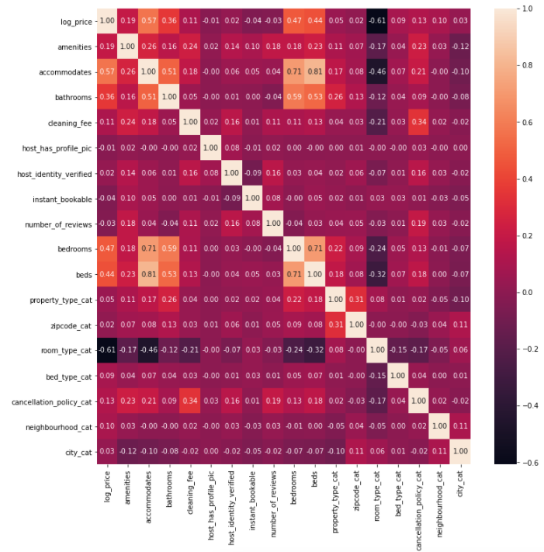
Feature Correlation Heat Map
#correlation graphs
import seaborn as sns
import matplotlib.pyplot as plt
plt.figure(figsize=(12,12))
sns.heatmap(data.corr(),annot=True,fmt='.2f')

Slide 8
Models
Linear Regression, Random Forest Regressor, Decision Tree Regressor, Adaboost Regressor that utilizes Linear Regression as the base estimator, Adaboost Regressor that utilizes Decision Tree Regressor as the base estimator, Bagging Regressor that utilizes Linear Regression as the base estimator, and Bagging Regressor that utilizes Decision Tree Regressor as the base estimator.
rf = RandomForestRegressor()
rf.fit(x_train,y_train)
mae = metrics.mean_absolute_error(y_test,rf.predict(x_test))
mae = 0.298

Slide 9
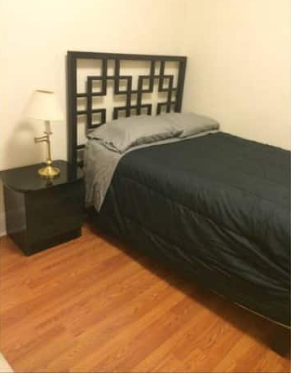
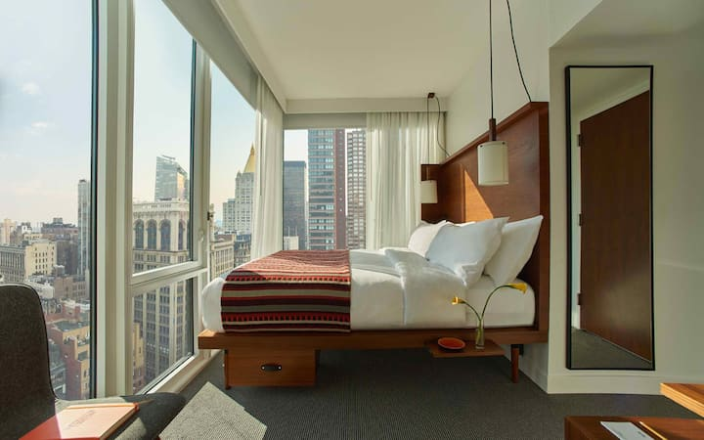
Future Work
An additional idea involves analyzing the photographs of airbnbs by training an image analysis model
Higher quality images (non blurred, professional camera) should correlate to a higher priced airbnb
More expensive furniture/amenities should also correlate to higher priced airbnb
Analyzing the description text off each airbnb with a Naive Bayes classifier
Instead of predicting price, predict location/neighbourhood
NYC, $37/night
NYC, $604/night

Slide 10
Summary
Most successful model was the Random Forest Regressor trained on scaled data, top 10 features selected by Recursive Feature Elimination
Successfully preprocessed data and created seven variations of regression models
Learned to use different python libraries to visualize data

